Slide 1
Package

Slide 2
A java package is a group of similar types of classes, interfaces and sub-packages.
Package in java can be categorized in two form, built-in package and user-defined package.
There are many built-in packages such as java, lang, awt, javax, swing, net, io, util, sql etc.
Advantage of Java Package
1) Java package is used to categorize the classes and interfaces so that they can be easily maintained.
2) Java package provides access protection.
3) Java package removes naming collision.

Slide 3
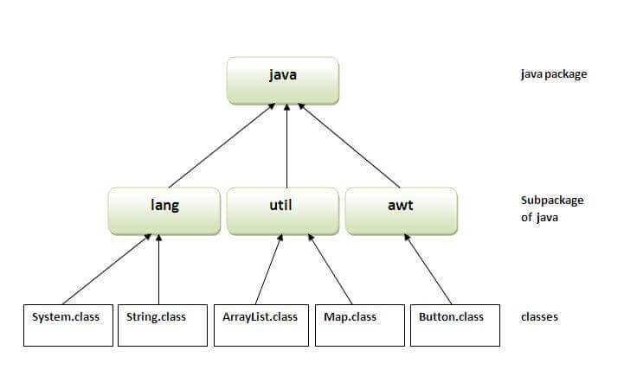

Slide 4
Access Modifiers in Java
The access modifiers in Java specifies the accessibility or scope of a field, method, constructor, or class.
We can change the access level of fields, constructors, methods, and class by applying the access modifier on it

Slide 5
There are four types of Java access modifiers:
Private: The access level of a private modifier is only within the class. It cannot be accessed from outside the class.
Default: The access level of a default modifier is only within the package. It cannot be accessed from outside the package. If you do not specify any access level, it will be the default.
Protected: The access level of a protected modifier is within the package and outside the package through child class. If you do not make the child class, it cannot be accessed from outside the package.
Public: The access level of a public modifier is everywhere. It can be accessed from within the class, outside the class, within the package and outside the package.

Slide 6
